Slide 1
Machine Learning for Gun Detection
MAE 551 - Arizona State University
Deep Patel
Erik Barraza-Cordova
Ziming Zhong

Slide 2
Introduction (background & Scope)
Gun Detection
Shootings in public spaces
Using existing CCTV systems for gun identification
Discovering the presence of a gun in someone’s possession on lower quality cameras
Value:
Prevention & Detection in security settings
Within cameras frames for analysis
Applications in Machine Learning can enhance human recognition & add a higher sense of security & accuracy in detection threats at public places or in high-security environments.

Slide 3
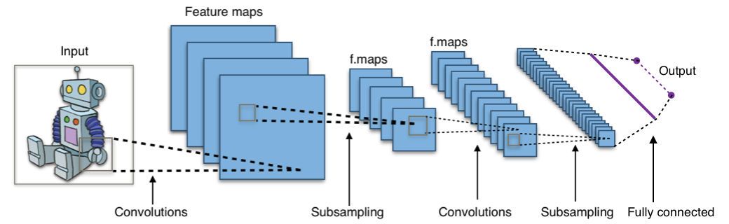
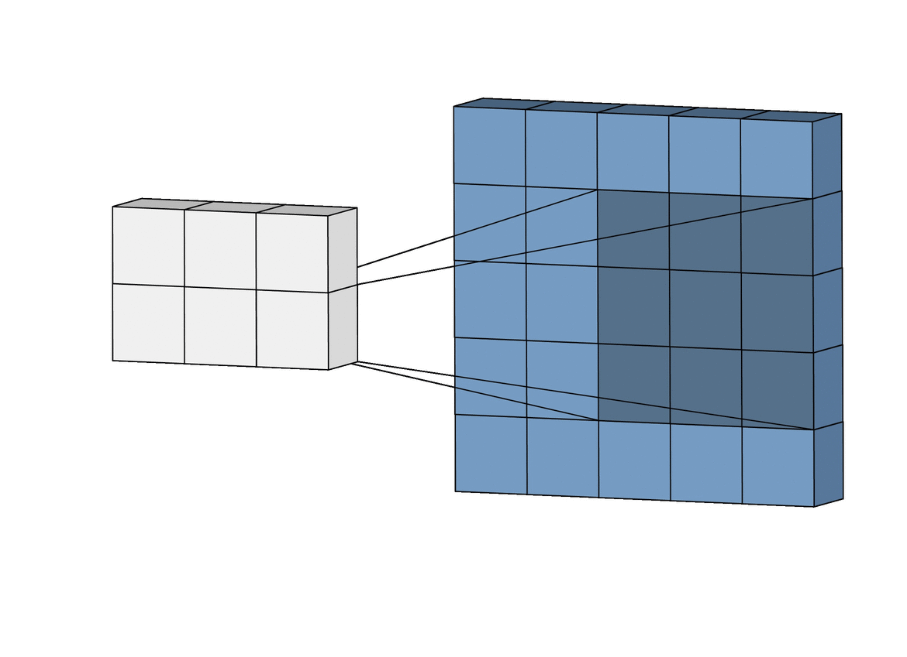
Introduction (Approach)
Convolutional Neural Networks
Libraries:
NumPy
Keras
Tensorflow

Slide 4
Methodology (CNN)
Importing Data and Preprocessing of Images
Test / Train / Validation Split of the Image Dataset
Training Data Set ~ 419,000 images
Testing Data Set ~ 2000 images
Validation Data Set ~ 2000 images
Using the Iterator “ImageDataGenerator from Keras API
Images resized to resolution 100 x 100
Converted to Greyscale Images
Vgg16 engine was utilized to preprocess the images
Data was distributed in batch-size of 50 images to perform batch gradient descent
Defining a function “dispImage” for visualization of data
This function displays one batch of images in the grid of 10 x 5
Utilizes the python library - matplot.lib

Slide 5
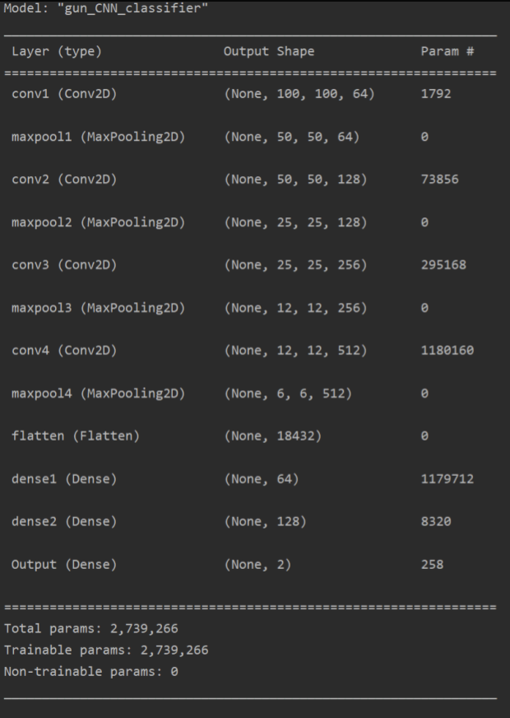
Methodology (Database Training)
Machine Learning Model
Model : Convolutional Neural Network
Model Configuration :
4 sets of Convolutional & Maxpooling layers
3 Layers - Fully Connected Neural Network
Regularization Param = 4 x 10^-3
Activation = ReLu

Slide 6
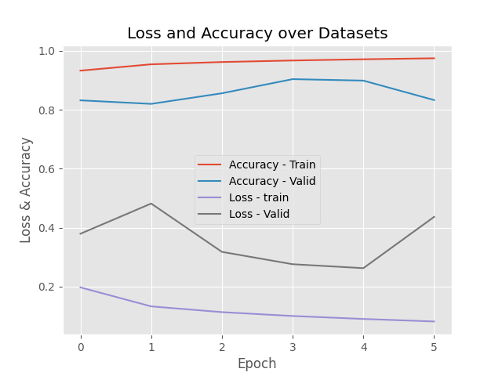
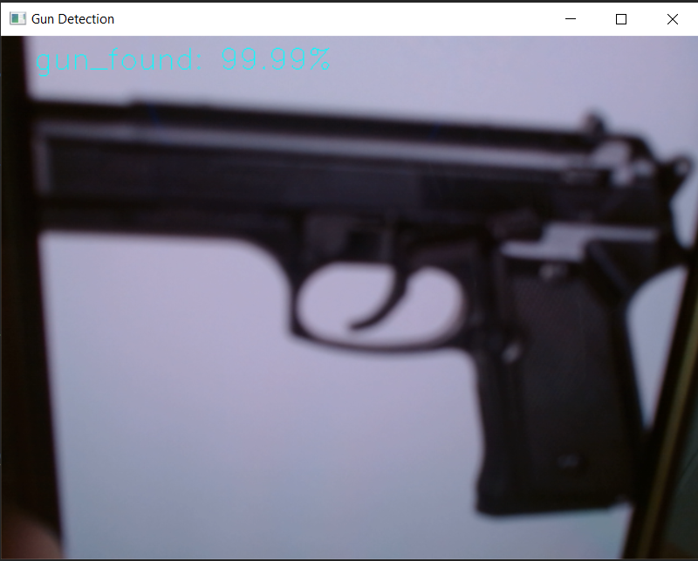
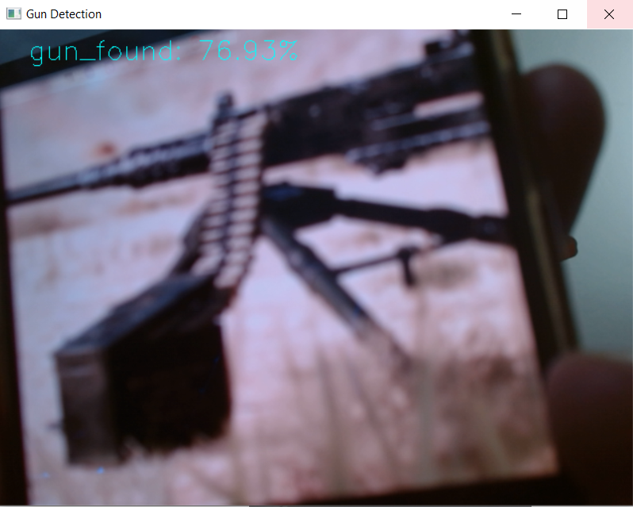
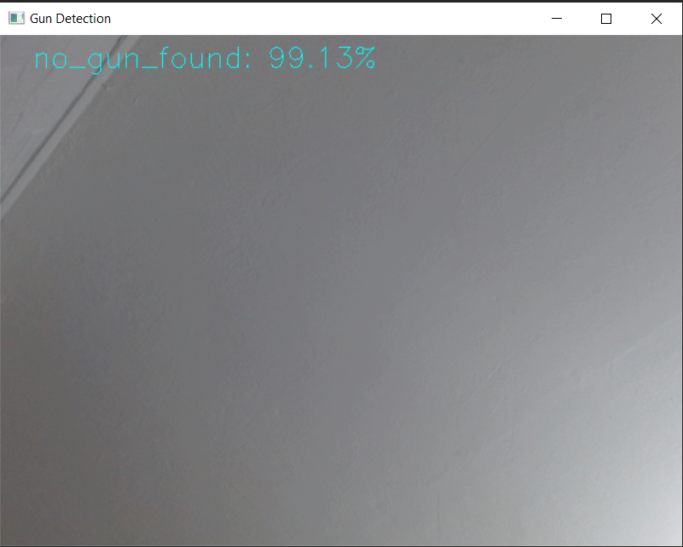
Discussion (Results)
Loss & Accuracy
Detected gun exist in the environment (Close to the camera)
Detected no gun exist in the environment

Slide 7
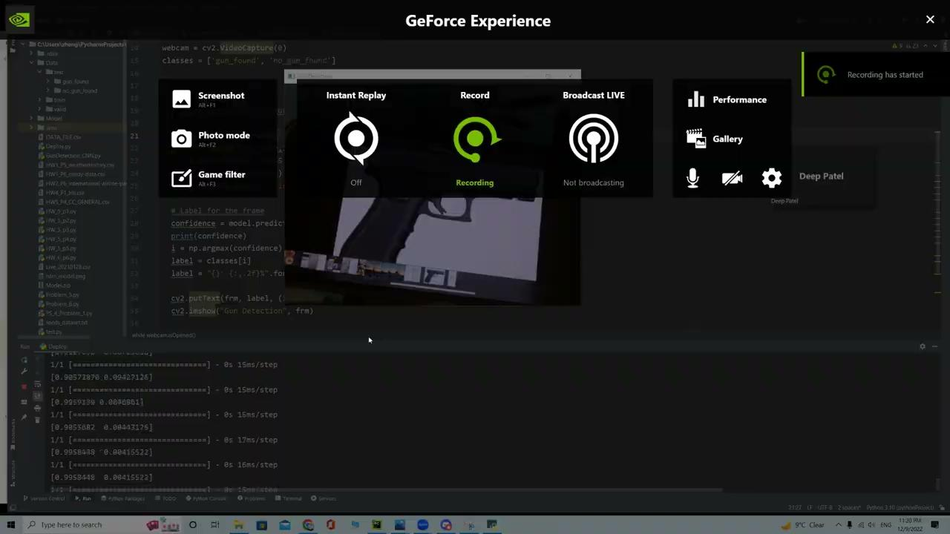
Discussion (Disadvantages)

Slide 8
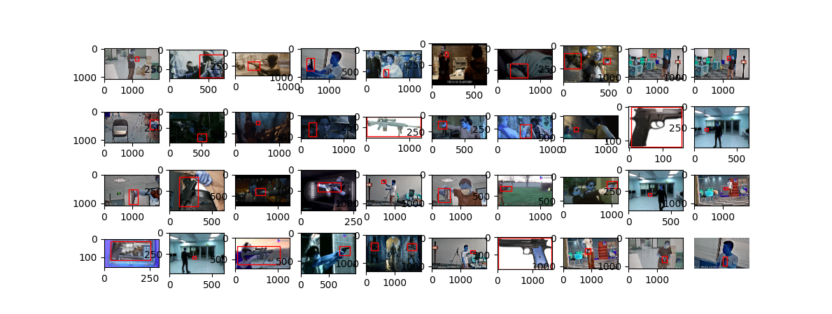
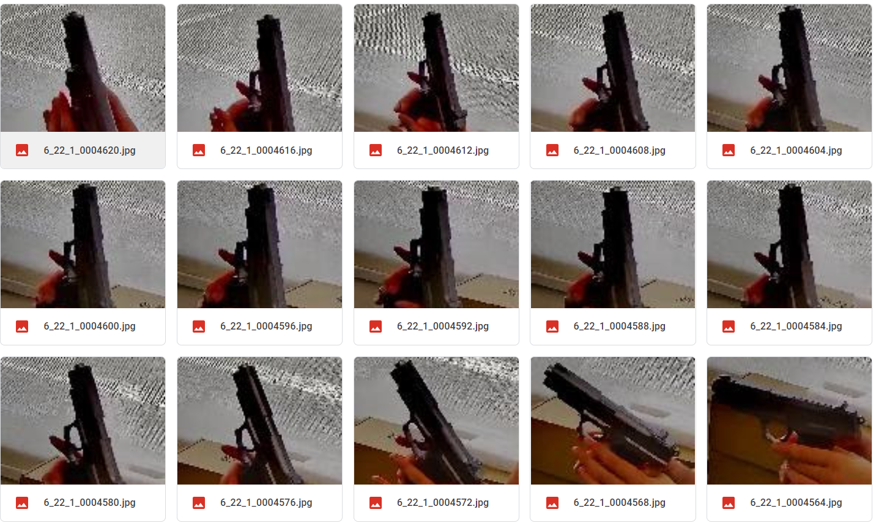
Conclusion & Next Steps:
Classification of different types of gun
Implementing an object tracing algorithm (Right)
Better quality gun photos
Bad Examples (below):

Slide 9
References:
https://paperswithcode.com/paper/a-gun-detection-dataset-and-searching-for
https://numfocus.org/sponsored-projects
https://keras.io/api/optimizers/
https://www.mdpi.com/2076-3417/11/16/7535/htm
https://www.researchgate.net/publication/353976271_Detection_and_Classification_of_Different_Weapon_Types_Using_Machine_Learning
https://www.ibm.com/cloud/learn/convolutional-neural-networks

